Slide 1

ACADEMIC CORE JAVA Object Orientation And Multi-Threading
HANDS-ON Training

Slide 2

03 JAVA Introduction
BEGIN

Slide 3
Trace a Program Execution
Enter main method
// This program prints Welcome to Java!
public class Welcome {
public static void main(String[] args) {
System.out.println("Welcome to Java!");
}
}
3

Slide 4
Trace a Program Execution
Execute statement
// This program prints Welcome to Java!
public class Welcome {
public static void main(String[] args) {
System.out.println("Welcome to Java!");
}
}
4

Slide 5
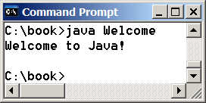
Trace a Program Execution
// This program prints Welcome to Java!
public class Welcome {
public static void main(String[] args) {
System.out.println("Welcome to Java!");
}
}
print a message to the console
5

Slide 6
Anatomy of a Java Program
Class name
Main method
Statements
Statement terminator
Reserved words
Comments
Blocks
6

Slide 7
Class Name
Every Java program must have at least one class. Each class has a name. By convention, class names start with an uppercase letter. In this example, the class name is Welcome.
// This program prints Welcome to Java!
public class Welcome {
public static void main(String[] args) {
System.out.println("Welcome to Java!");
}
}
7

Slide 8
Main Method
Line 2 defines the main method. In order to run a class, the class must contain a method named main. The program is executed from the main method.
// This program prints Welcome to Java!
public class Welcome {
public static void main(String[] args) {
System.out.println("Welcome to Java!");
}
}
8

Slide 9
Statement
A statement represents an action or a sequence of actions. The statement System.out.println("Welcome to Java!") in the program is a statement to display the greeting "Welcome to Java!“.
// This program prints Welcome to Java!
public class Welcome {
public static void main(String[] args) {
System.out.println("Welcome to Java!");
}
}
9

Slide 10
Statement Terminator
Every statement in Java ends with a semicolon (;).
// This program prints Welcome to Java!
public class Welcome {
public static void main(String[] args) {
System.out.println("Welcome to Java!");
}
}
10

Slide 11
Reserved words
Reserved words or keywords are words that have a specific meaning to the compiler and cannot be used for other purposes in the program. For example, when the compiler sees the word class, it understands that the word after class is the name for the class.
// This program prints Welcome to Java!
public class Welcome {
public static void main(String[] args) {
System.out.println("Welcome to Java!");
}
}
11

Slide 12
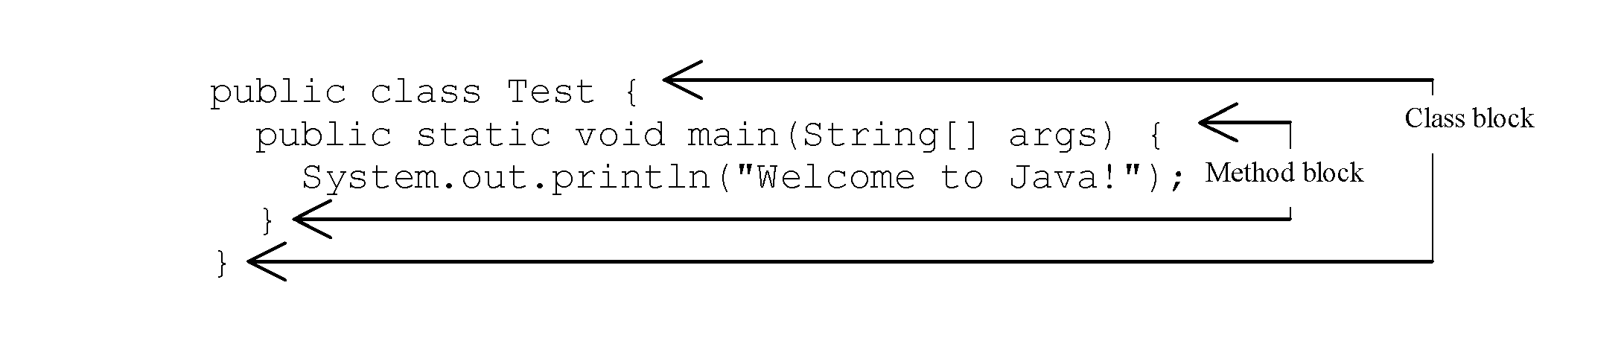
Blocks
A pair of braces in a program forms a block that groups components of a program.
12

Slide 13
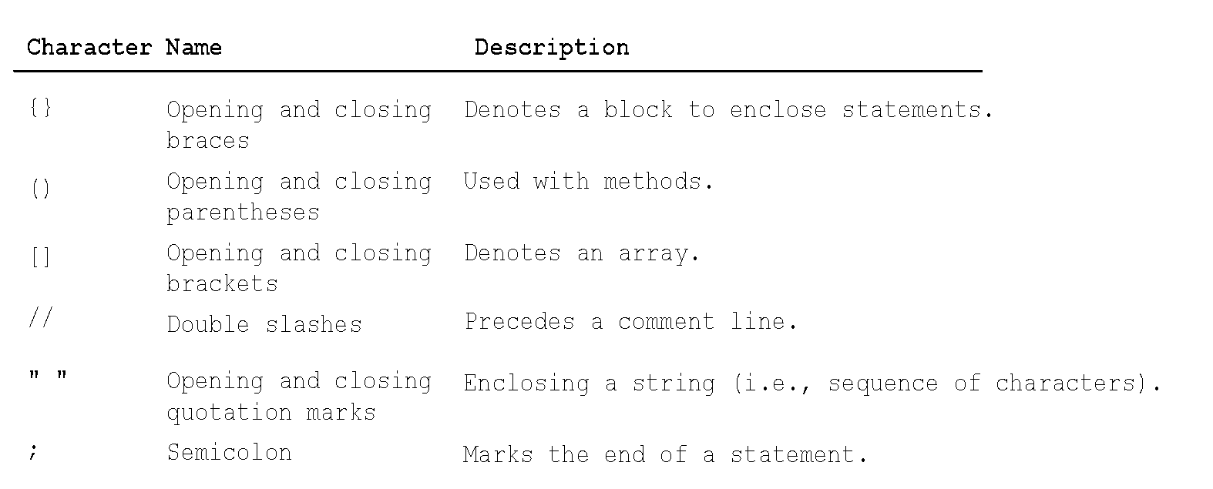
Special Symbols
13

Slide 14
{ … }
// This program prints Welcome to Java!
public class Welcome {
public static void main(String[] args) {
System.out.println("Welcome to Java!");
}
}
14

Slide 15
( … )
// This program prints Welcome to Java!
public class Welcome {
public static void main(String[] args) {
System.out.println("Welcome to Java!");
}
}
15

Slide 16
;
// This program prints Welcome to Java!
public class Welcome {
public static void main(String[] args) {
System.out.println("Welcome to Java!");
}
}
16

Slide 17
// …
// This program prints Welcome to Java!
public class Welcome {
public static void main(String[] args) {
System.out.println("Welcome to Java!");
}
}
17

Slide 18
" … "
// This program prints Welcome to Java!
public class Welcome {
public static void main(String[] args) {
System.out.println("Welcome to Java!");
}
}
18

Slide 19
Programming Style and Documentation
Appropriate Comments
Naming Conventions
Proper Indentation and Spacing Lines
Block Styles
19

Slide 20
Appropriate Comments
Include a summary at the beginning of the program to explain what the program does, its key features, its supporting data structures, and any unique techniques it uses.
Include your name, class section, instructor, date, and a brief description at the beginning of the program.
20

Slide 21
Naming Conventions
Choose meaningful and descriptive names.
Class names:
Capitalize the first letter of each word in the name. For example, the class name ComputeExpression.
21

Slide 22
Proper Indentation and Spacing
Indentation
Indent two spaces.
Spacing
Use blank line to separate segments of the code.
22

Slide 23
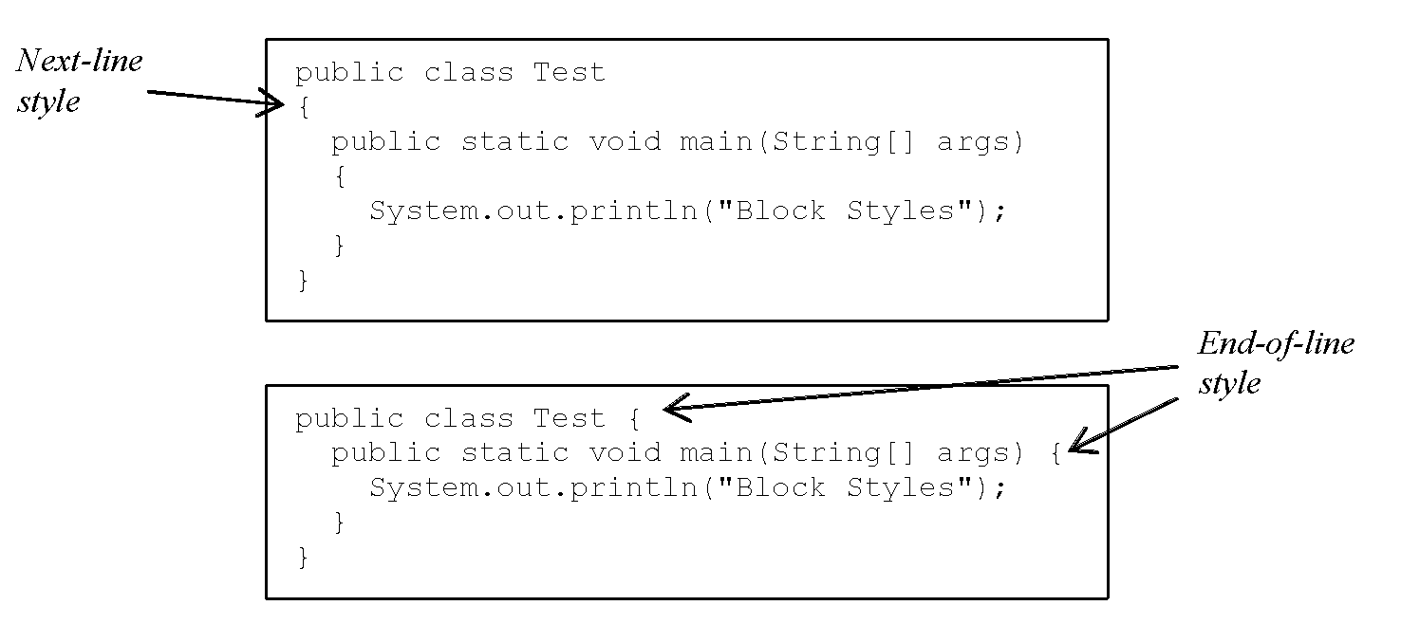
Block Styles
Use end-of-line style for braces.
23

Slide 24
Programming Errors
Syntax Errors
Detected by the compiler
Runtime Errors
Causes the program to abort
Logic Errors
Produces incorrect result
24

Slide 25
Syntax Errors
public class ShowSyntaxErrors {
// This code has syntax error by purpose
public static main(String[] args) {
System.out.println("Welcome to Java);
}
25
Notes:
Will not compile!!
Errors:
public static void main (String[] args)
closing quotation
and closing bracket

Slide 26
Runtime Errors
// Program contains runtime errors
public class ShowRuntimeErrors {
public static void main(String[] args) {
System.out.println(1 / 0);
}
}
26
Notes:
Will compile, but it won’t run completely. It will stop when it finds the error in this case - won’t divide by zero. We’ll see this more when we work with arrays.

Slide 27
Logic Errors
public class ShowLogicErrors {
public static void main(String[] args) {
System.out.print("Celsius 35 is ");
System.out.print("Fahrenheit ");
System.out.println((9 / 5) * 35 + 32);
}
}
27
Notes:
Will successfully compile and execute, but it will not give you the correct output.

Slide 28
Implicit Import and Explicit Import
import java.util.* ; //Implicit import
import java.util.JOptionPane; //Explicit import
No performance difference
28
Notes:
Imports library

Slide 29
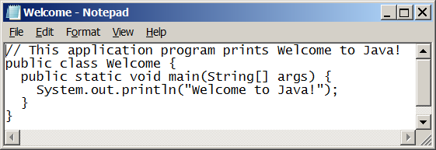
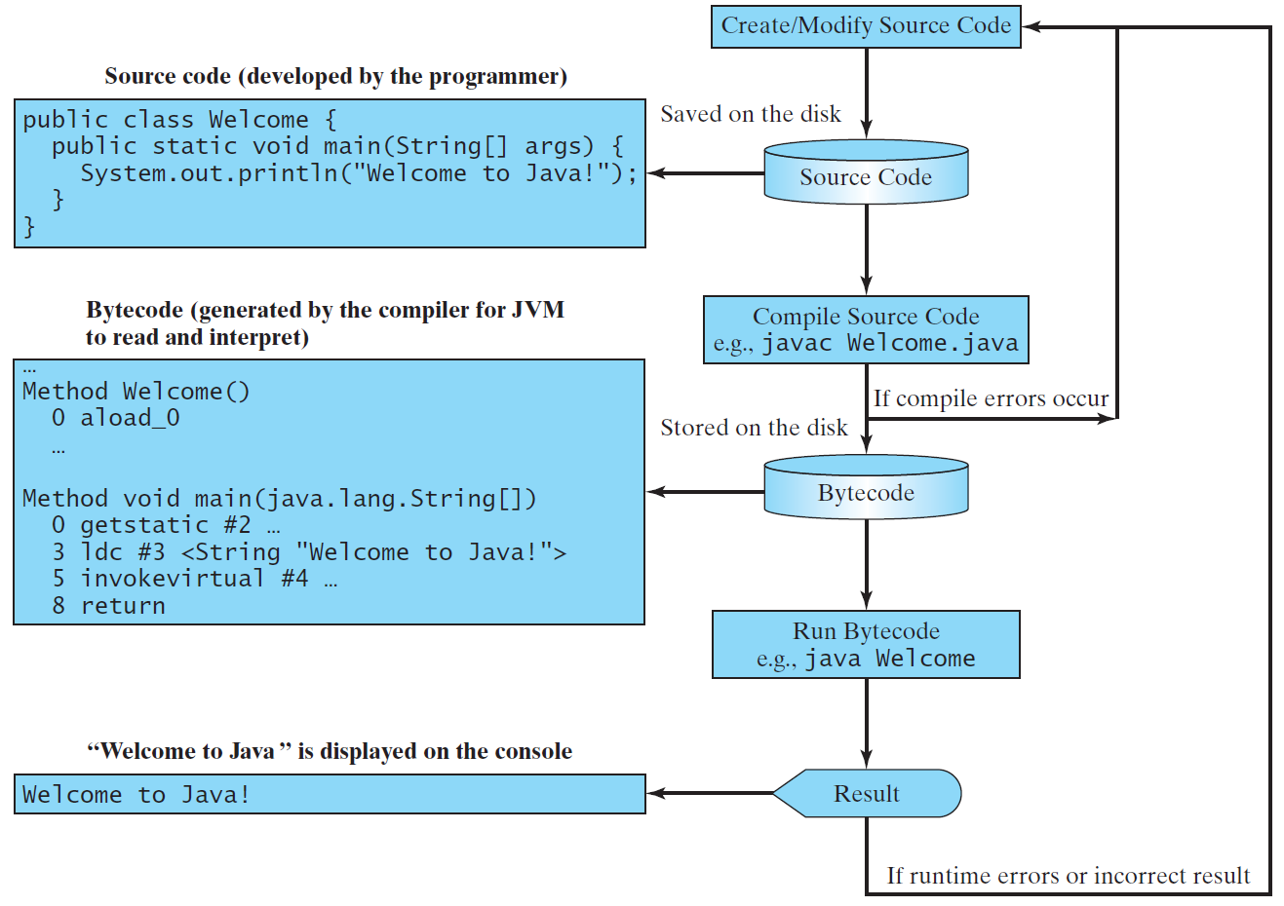
Creating, Compiling, and Running Programs
29

Slide 30
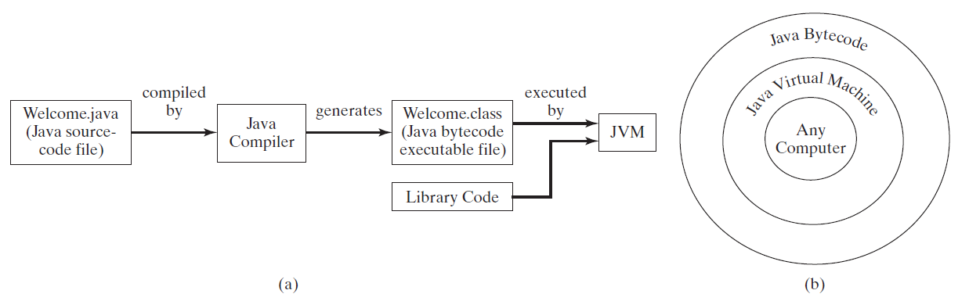
Compiling Java Source Code
Java can be compiled into a special type of object code, known as bytecode. This bytecode can run (interpreted) on any computer using JVM (Java Virtual Machine) software.
30
Notes:
Computers are networked to work together. Java was designed to run object programs on any platform. With Java, you write the program once, and compile the source program into a special type of object code, known as bytecode. The bytecode can then run on any computer with a Java Virtual Machine, as shown below. Java Virtual Machine is software that interprets Java bytecode.

Slide 31
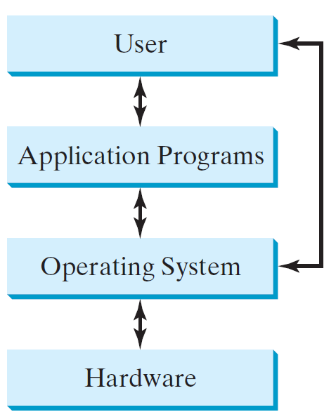
Operating Systems
The operating system (OS) is a program that manages and controls a computer’s activities and file system.
Popular operating systems are Microsoft Windows, Mac OS, and Linux.
Application programs, such as a Web browser or a word processor, cannot run unless an operating system is installed and running on the computer.
31
Notes:
The OS schedules jobs.

Slide 32
Characteristics of Java
Java is relatively simple
Java bytecode is Interpreted (JVM) but can also be compiled to native machine code
Java is Architecture and OS neutral
Java’s performance keeps improving
32
Notes:
I greatly simplified the end java discussion

Slide 33

END

